Slide 1
Alt-Ergo for Validity Check
Dr.S.Padmavathi
CSE, Amrita School of Engineering
Coimbatore

Slide 2
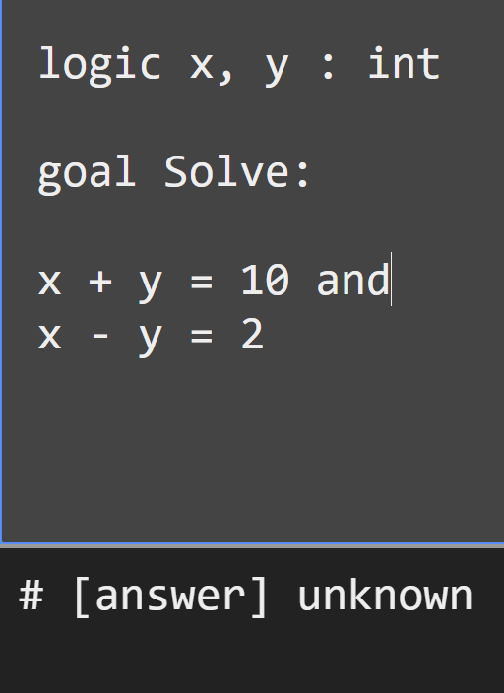
Alt-Ergo Checks Validity
Alt-Ergo
Online Tool:
https://alt-ergo.ocamlpro.com/try.html
Reference: Dr.Bharat Jayaraman, Unviversity of Buffalo, CSE449-459 Software verification course, Spring 2020.

Slide 3
Alt-Ergo Examples
valid
unknown
goal g_8 :
forall x,y:int.
x*x = 64 -> x = 8 or x = -8
goal g_8 :
forall x,y:int.
x=1 -> x+1=2
goal g_8 :
forall x,y:int.
x*x = 64 -> x = 9 or x = -8
goal g_8 :
forall x,y:int.
x=1 and x+1=2

Slide 4
Preposition in Alt-Ergo
Symbols
Example
￢ not
∧ and
∨ or
→ ->
↔ <->
￢p not p
p ∧ q p and q
p ∨ q p or q
p→q p -> q
p↔ q p <-> q

Slide 5
Equivalent
Demorgan’s law:
￢(p ∧ q) ≡ ￢p∨￢q
Distributive law:
p ∧ (q ∨ r) ≡ (p ∧ q) ∨ (p ∧ r)
logic p,q,r,s,t:prop
goal g_8 :
not( p or q)
<->
not p and not q
logic p,q,r,s,t:prop
goal g_8 :
p and ( q or r)
<->
( p and q )or (p and r)

Slide 6
Sequent in Alt-Ergo
P ∧￢Q → R, ￢R, P ├ Q
(p ∧ q) ∧ r, s ∧ t ├ q ∧ s
logic p,q,r:prop
goal g_8 :
p and not q->r and
not r and p->q
# [message] Inconsistent assumption # [answer] Valid (0.0080 seconds) (3 steps)
logic p,q,r,s,t:prop
goal g_8 :
(p and q) and r and
s and t -> q and s

Slide 7
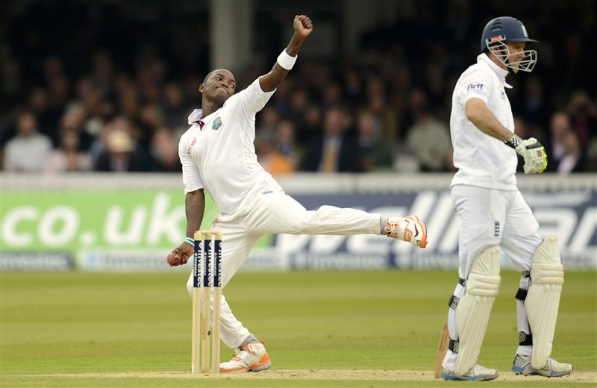
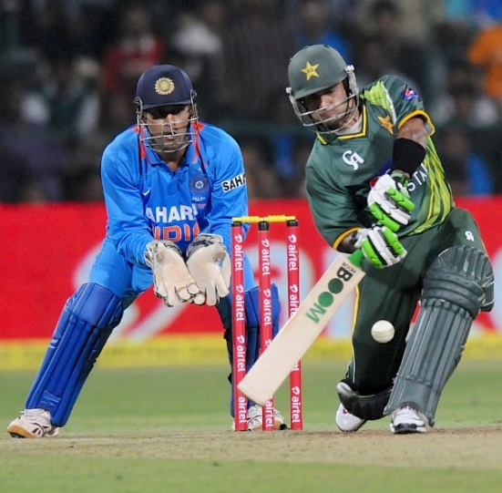
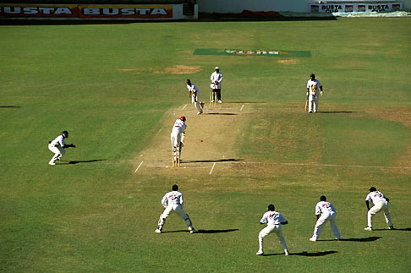
Cricket Match ☺
Reference: Dr.Bharat Jayaraman, Unviversity of Buffalo, CSE449-459 Software verification course, Spring 2020.

Slide 8
Propositional Variables
d1: It is Monday.
d2: It is Tuesday.
d3: It is Wednesday.
d4: It is Thursday.
d5: It is Friday.
d6: It is Saturday.
d7: It is Sunday.
m: There is a match today.
r: It is raining today.
t: The teams are ready today.
Reference: Dr.Bharat Jayaraman, Unviversity of Buffalo, CSE449-459 Software verification course, Spring 2020.

Slide 9
Constraints on a Match
It is Monday or Tuesday … or Sunday.
Cricket matches can be played only on Monday, Friday, Saturday, and Sunday.
A cricket match can be played only if it is not raining and the teams are ready.
It rains every Tuesday, Friday, and Saturday.
Teams are ready on every day except Monday.
Let’s take them one by one …
Reference: Dr.Bharat Jayaraman, Unviversity of Buffalo, CSE449-459 Software verification course, Spring 2020.

Slide 10
Encode in Propositional Logic
It is Monday or Tuesday or Wednesday or Thursday or Friday or Saturday or Sunday
d1 \/ d2 \/ d3 \/ d4 \/ d5 \/ d6 \/ d7
This is good, but can it be improved?
More precise:
d1 /\ ¬ (d2 \/ d3 \/ d4 \/ d5 \/ d6 \/ d7)
\/ … \/
d7 /\ ¬ (d1 \/ d2 \/ d3 \/ d4 \/ d5 \/ d6)
Reference: Dr.Bharat Jayaraman, Unviversity of Buffalo, CSE449-459 Software verification course, Spring 2020.

Slide 11
Matches can be played only on Monday, Friday, Saturday, and Sunday.
m → d1 \/ d5 \/ d6 \/ d7
A match can be played only if it is not raining and the teams are ready.
m →
¬r /\ t
Reference: Dr.Bharat Jayaraman, Unviversity of Buffalo, CSE449-459 Software verification course, Spring 2020.

Slide 12
It rains every Tuesday, Friday, and Saturday.
d2 → r /\
d5 → r /\
d6 → r
Teams are ready on every day except Monday.
t → ¬d1 /\
¬d1 → t
Reference: Dr.Bharat Jayaraman, Unviversity of Buffalo, CSE449-459 Software verification course, Spring 2020.

Slide 13
“Theory of Cricket Matches”
The five propositions can be considered as Axioms of the Theory of Cricket Matches:
d1 \/ d2 \/ d3 \/ d4 \/ d5 \/ d6 \/ d7
2. m → d1 \/ d5 \/ d6 \/ d7
3. m → ¬r /\ t
4. d2 → r /\ d5 → r /\ d6 → r
5. t → ¬d1 /\ ¬d1 → t
Reference: Dr.Bharat Jayaraman, Unviversity of Buffalo, CSE449-459 Software verification course, Spring 2020.

Slide 14
Theory and Theorem
A Theorem that follows from the Theory of Cricket
Matches, C, is:
m → d7
That is, a cricket match can be played only on Sunday. Letting T = (m → d7), we can write
C |= T
That is, T is a logical consequence of C.
Reference: Dr.Bharat Jayaraman, Unviversity of Buffalo, CSE449-459 Software verification course, Spring 2020.

Slide 15
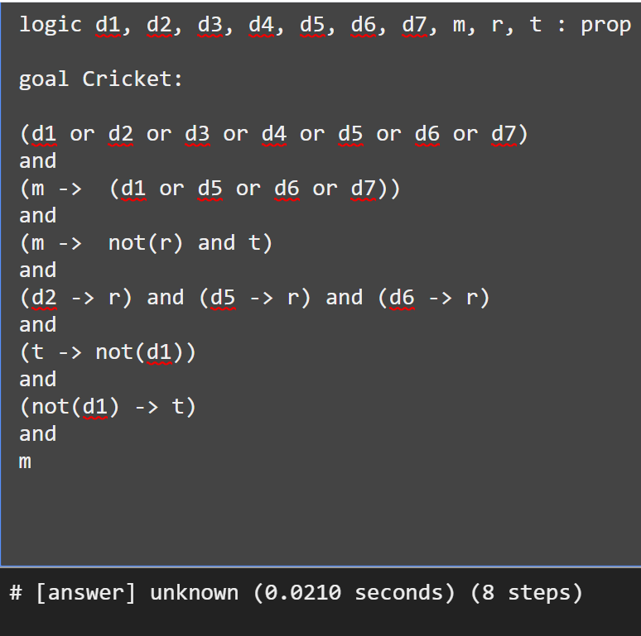
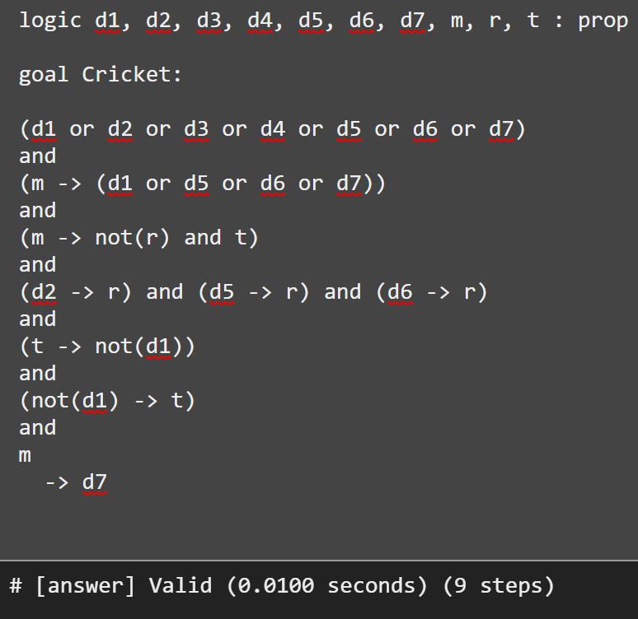
Alt-Ergo checks Validity
A match is to be played
but day unspecified
A match is to be
played on Sunday
Using ‘or’ instead of ‘exclusive or’, as ‘xor’ is not supported.
Reference: Dr.Bharat Jayaraman, Unviversity of Buffalo, CSE449-459 Software verification course, Spring 2020.

Slide 16
Exercise- sequent in Alt-Ergo
For the sequent below, show which ones are valid and which ones aren’t:
(a) ￢p → ￢q ├ q → p
(b) ￢p ∨ ￢q ├ ￢(p ∧ q)
(c) ￢p, p ∨ q ├ q
(d) p ∨ q,￢q ∨ r ├ p ∨ r
(e) p → (q ∨ r),￢q,￢r ├ ￢p
(f) ￢p ∧ ￢q ├ ￢(p ∨ q)
(g) p ∧ ￢p ├ ￢(r → q) ∧ (r → q)
(h) p → q, s → t ├ p ∨ s → q ∧ t
(i) ￢(￢p ∨ q) ├ p.

Slide 17
Exercise- sequent in Alt-Ergo
(1) ￢p ∨ (q → p) ├ ￢p ∧ q
(2) ￢r → (p ∨ q), r ∧￢q ├ r → q
(3) p → (q → r) ├ p → (r → q)
(4) ￢p, p ∨ q ├ ￢q
(5) p → (￢q ∨ r),￢r ├ ￢q →￢p.
(6) p ∨ q ├ p ∧ q
(7) ￢p → ￢q ├ ￢q → ￢p
(8) p → q ├ p ∨ q
(9) p → (q ∨ r) ├(p → q) ∧ (p → r).

Slide 18
Exercise- Propositional statement
Formalize the following sentences:
1. “If Davide comes to the party then Bruno and Carlo come too”
2. “Carlo comes to the party only if Angelo and Bruno do not come”
3. “Davide comes to the party if and only if Carlo comes and Angelo doesn’t come”
4. “If Davide comes to the party, then, if Carlo doesn’t come then Angelo comes”
5. “Carlo comes to the party provided that Davide doesn’t come, but, if Davide comes, then Bruno doesn’t come”
6. “A necessary condition for Angelo coming to the party, is that, if Bruno
and Carlo aren’t coming, Davide comes”
7. “Angelo, Bruno and Carlo come to the party if and only if Davide doesn’t come, but, if neither Angelo nor Bruno come, then Davide comes only if Carlo comes”

Slide 19
Solution
Let’s consider a propositional language where
A =“Angelo comes to the party”,
B =“Bruno comes to the party”,
C =“Carlo comes to the party”,
D =“Davide comes to the party”.
Solution.
1. D →B ^ C
2. C →￢A ^ ￢B
3. D ↔ (C ^ ￢A)
4. D →(￢C →A)
5. (￢D →C) ^ (D →￢B)
6. A →(￢B ^ ￢C →D)
7. (A ^ B ^ C ↔ ￢D) ^ (￢A ^ ￢B →(D ↔ C))

Slide 20
Exercise- solving puzzle
Three boxes are presented to you. One contains gold, the other two are empty.
Each box has imprinted on it a clue as to its contents; the clues are:
Box 1 “The gold is not here”
Box 2 “The gold is not here”
Box 3 “The gold is in Box 2”
Only one message is true; the other two are false. Which box has the gold?
Formalize the puzzle in Propositional Logic and find the solution and verify in Alt-Ergo

Slide 21
Solution
Solution.
Let Bi with i Є {1,2,3} stand for “gold is in the i-th box”.
We can formalize the statements of the problem as follows:
1. One box contains gold, the other two are empty.
(B1 ^ ￢B2 ^ ￢B3) V(￢B1 ^ B2 ^ ￢B3) V (￢B1 ^ ￢B2 ^ B3) (2.1)
2. Only one message is true; the other two are false.
(￢B1 ^ ￢￢B2 ^ ￢B2) V(￢￢B1 ^ ￢B2 ^ ￢B2) V (￢￢B1 ^ ￢￢B2 ^ B2) (2.2)
(2.2) is equivalent to: (B1 ^ ￢B2) V(B1 ^ B2) (2.3)
The only assignment I that verifies both (2.1) and (2.3) is the one with I(B1) =T and I(B2) = I(B3) = F,
which implies that the gold is in the first box.

Slide 22
Exercise
Derive the propositional statement, sequent for the statements given below and verify in Alt-Ergo.
If it is raining and Jane does not have her umbrella with her,then she will get wet.
Jane is not wet.
It is raining.
Therefore, Jane has her umbrella with her.

Slide 23
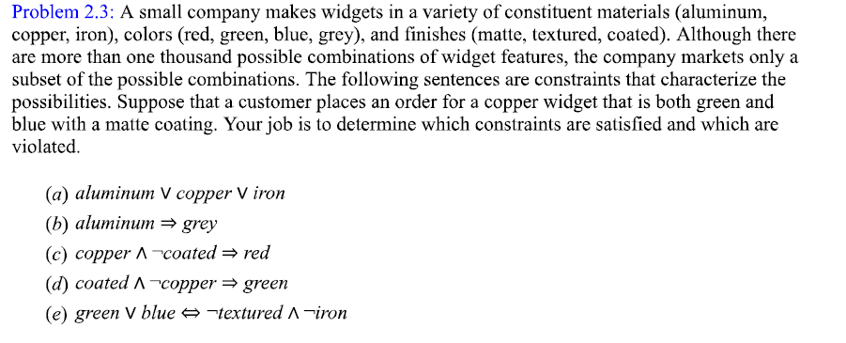
Exercise
Reference: Stanford University chapter

Slide 24
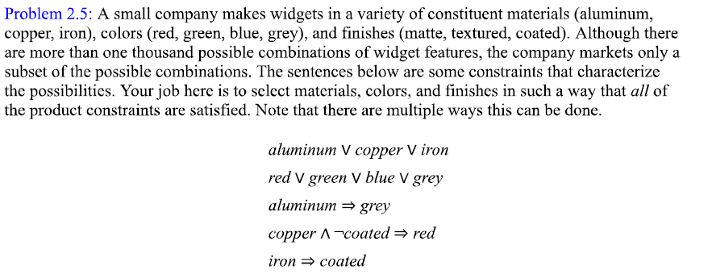
Exercise
Reference: Stanford University chapter

Slide 25
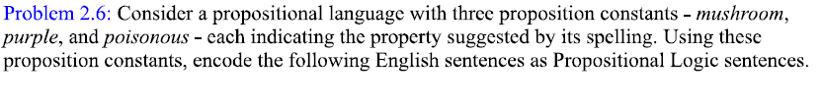
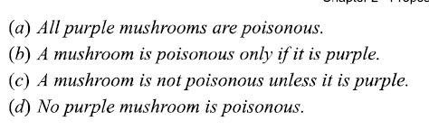
Exercise
Reference: Stanford University chapter

